Slide 1

Notes:
Screenshot 2026-10-28 154358.png

Slide 2
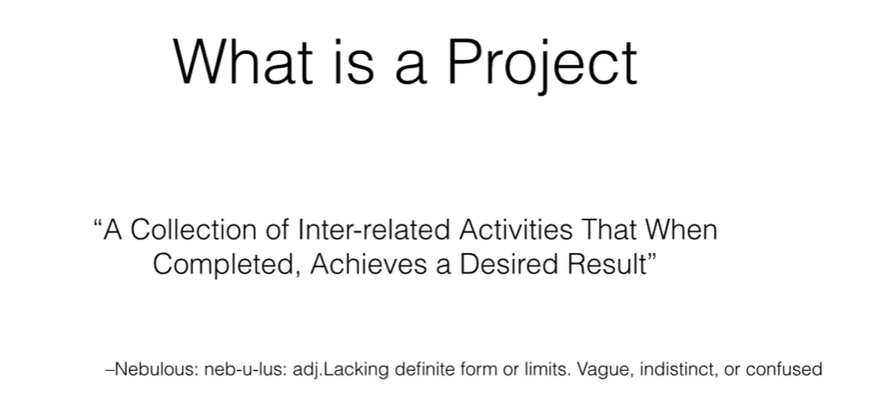
Notes:
Screenshot 2026-10-28 154433.png

Slide 3
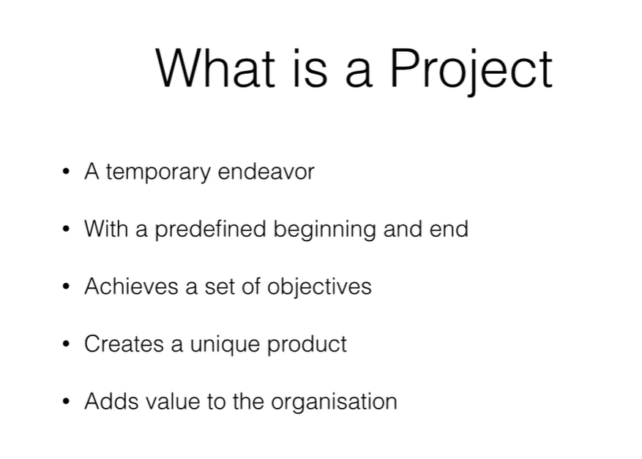
Notes:
Screenshot 2026-10-28 154447.png

Slide 4
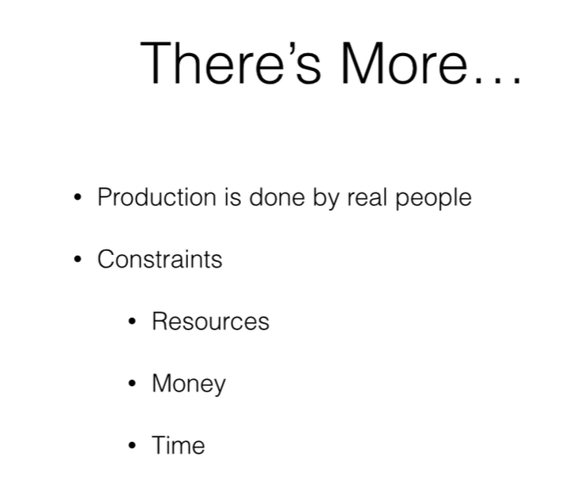
Notes:
Screenshot 2026-10-28 154505.png

Slide 5
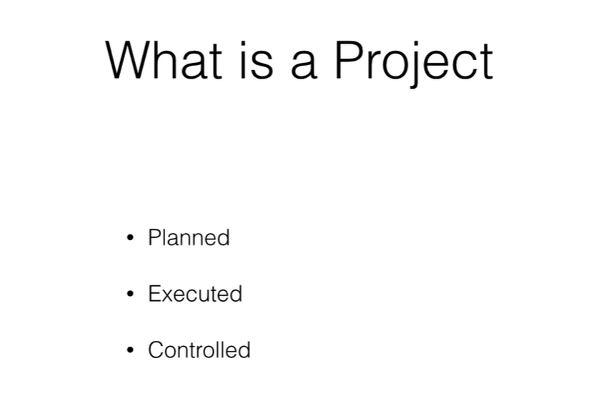
Notes:
Screenshot 2026-10-28 154517.png

Slide 6
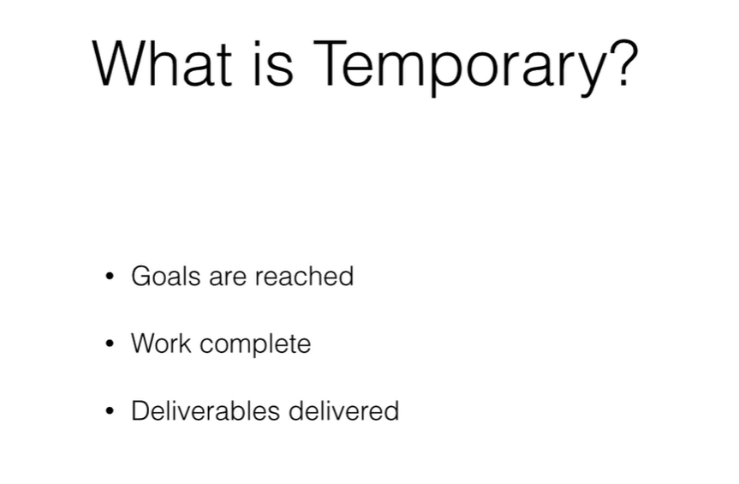
Notes:
Screenshot 2026-10-28 154529.png

Slide 7
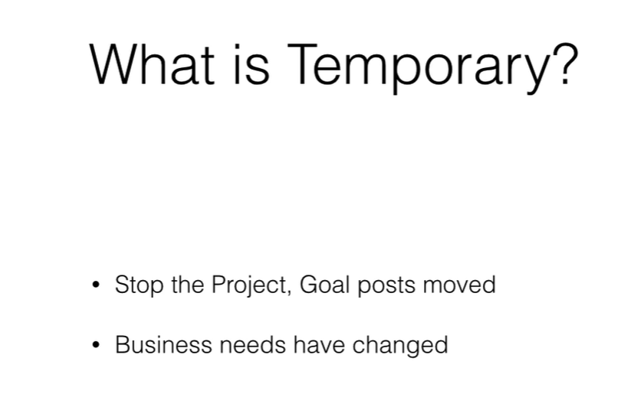
Notes:
Screenshot 2026-10-28 154541.png

Slide 8
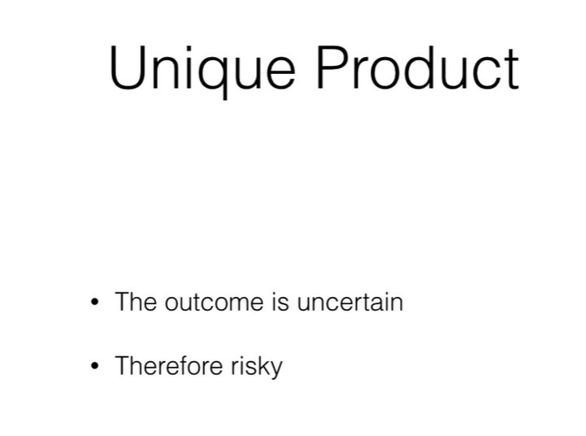
Notes:
Screenshot 2026-10-28 154551.png

Slide 9
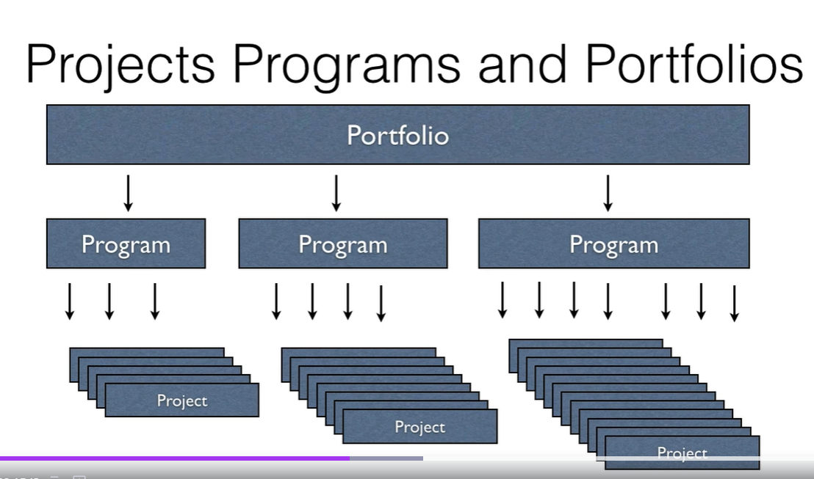
Notes:
Screenshot 2026-10-28 154625.png

Slide 10
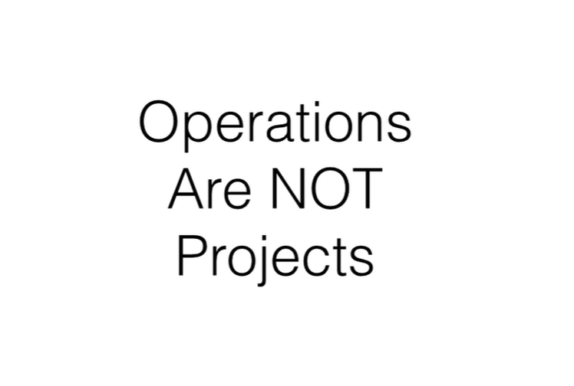
Notes:
Screenshot 2026-10-28 154824.png

Slide 11

Notes:
Screenshot 2026-10-28 155003.png

Slide 12
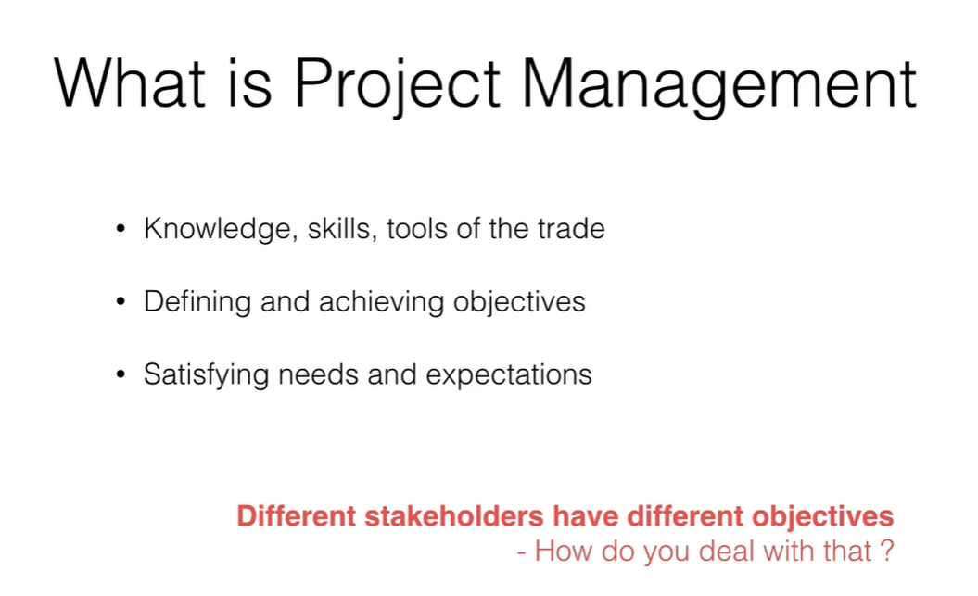
Notes:
Screenshot 2026-10-28 155021.png

Slide 13
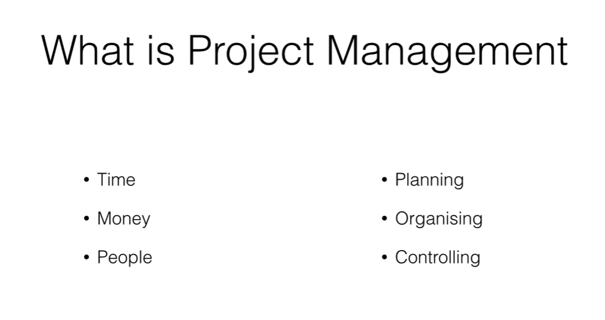
Notes:
Screenshot 2026-10-28 155107.png

Slide 14
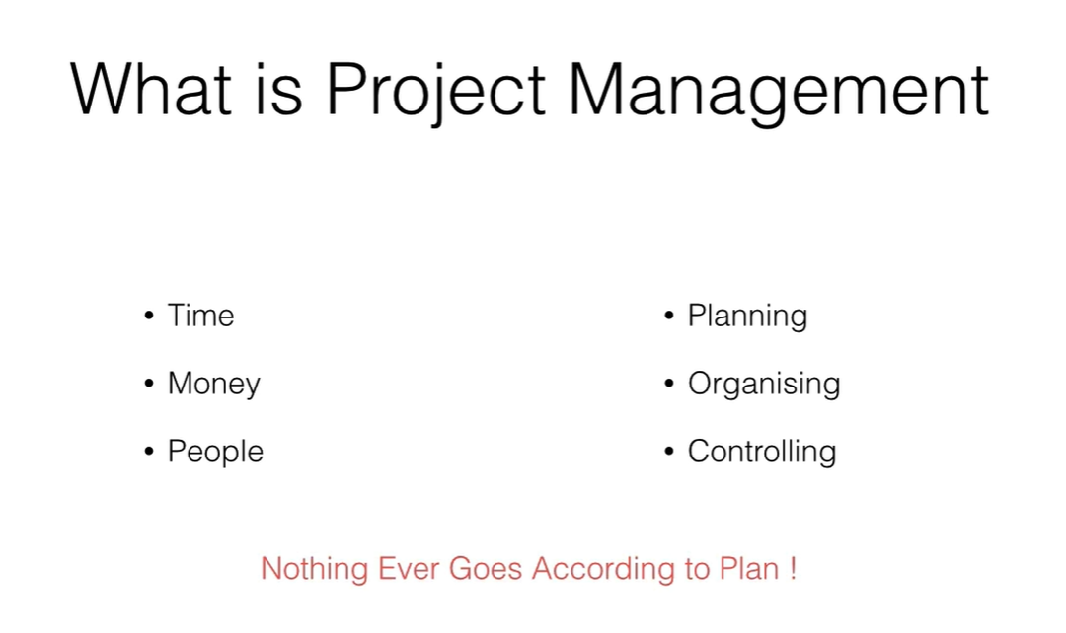
Notes:
Screenshot 2026-10-28 155113.png

Slide 15
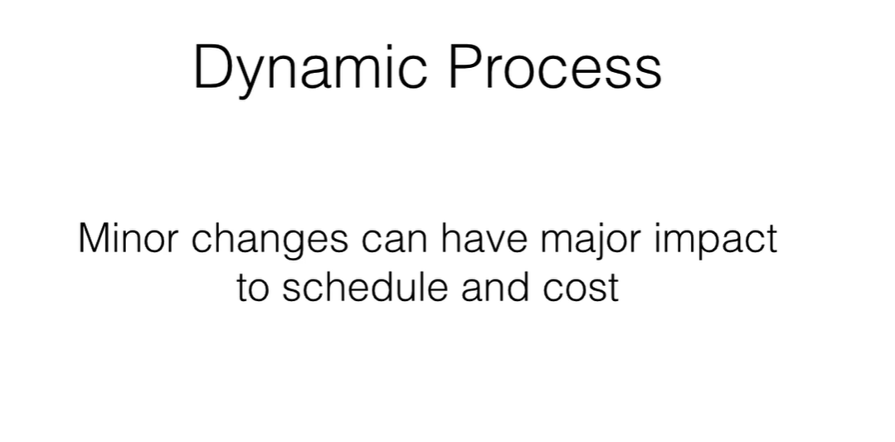
Notes:
Screenshot 2026-10-28 155133.png

Slide 16
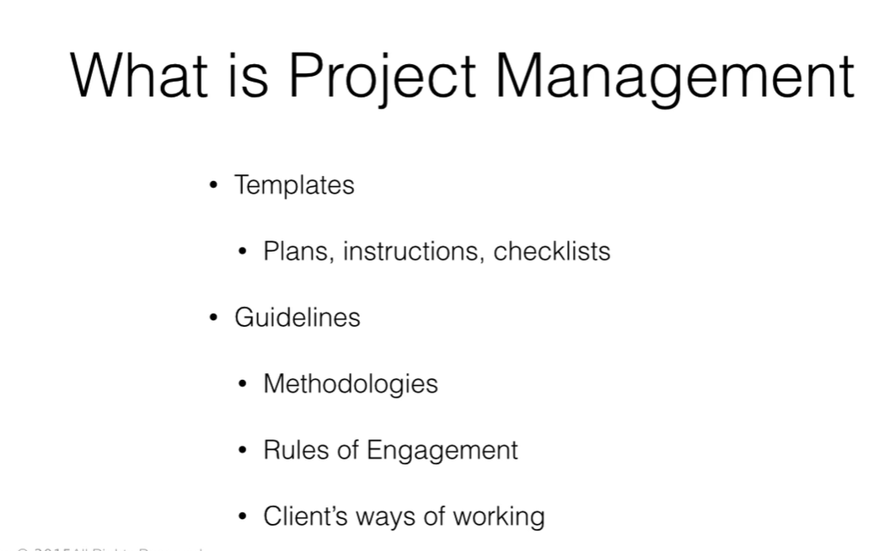
Notes:
Screenshot 2026-10-28 155204.png

Slide 17
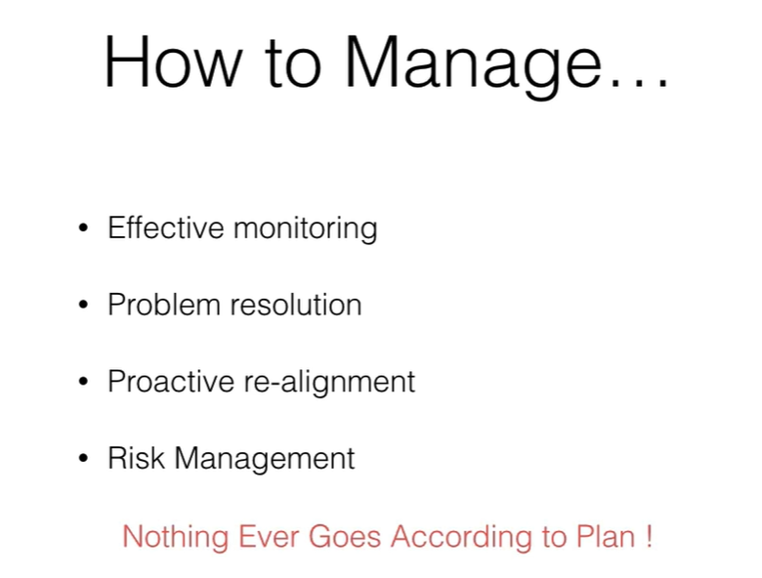
Notes:
Screenshot 2026-10-28 155246.png

Slide 18
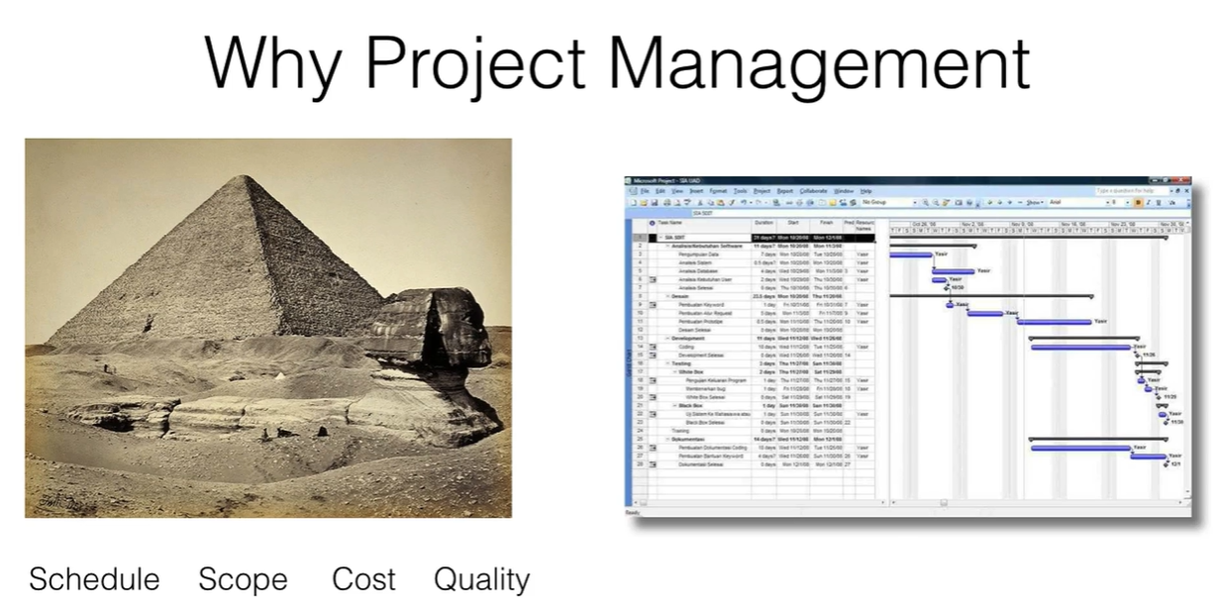
Notes:
Screenshot 2026-10-28 155319.png

Slide 19
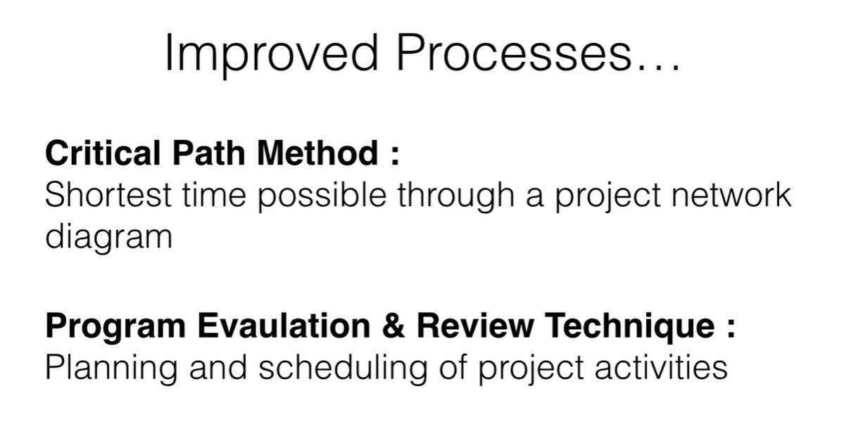
Notes:
Screenshot 2026-10-28 155344.png

Slide 20
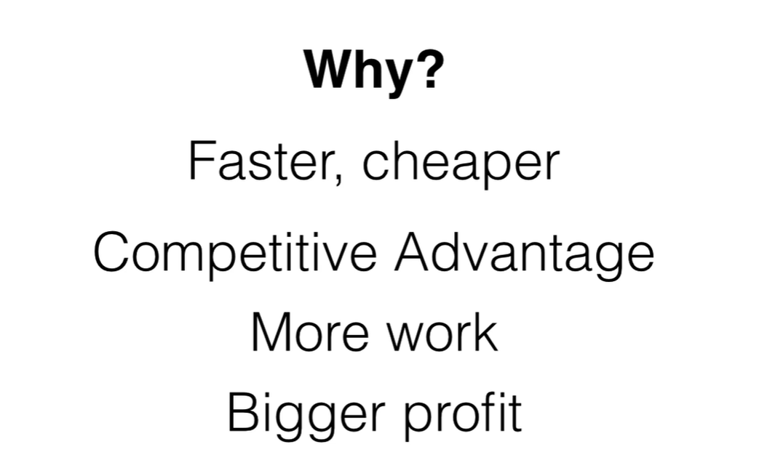
Notes:
Screenshot 2026-10-28 155506.png

Slide 21

Notes:
Screenshot 2026-10-28 155540.png

Slide 22
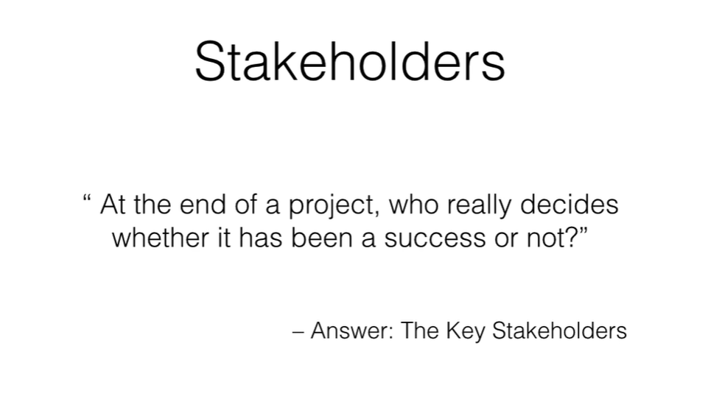
Notes:
Screenshot 2026-10-28 155601.png

Slide 23
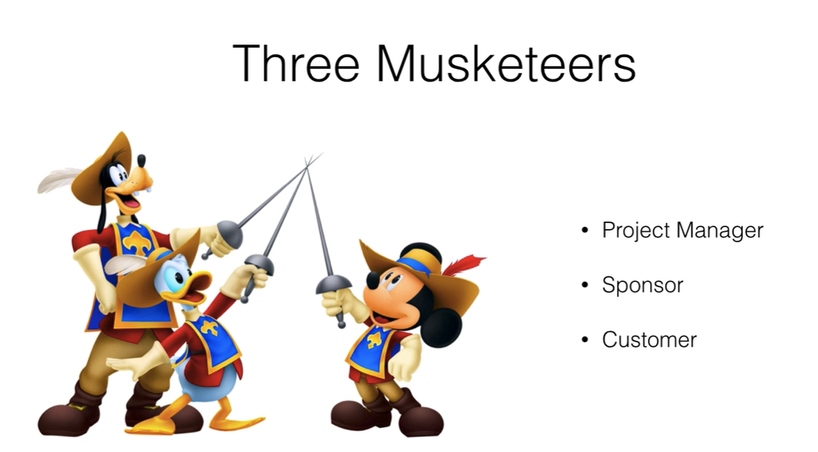
Notes:
Screenshot 2026-10-28 155634.png

Slide 24
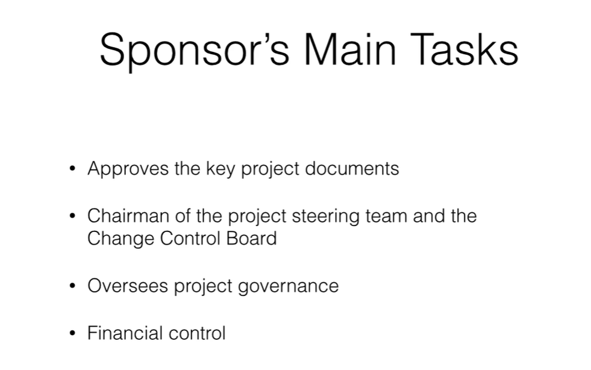
Notes:
Screenshot 2026-10-28 155720.png

Slide 25
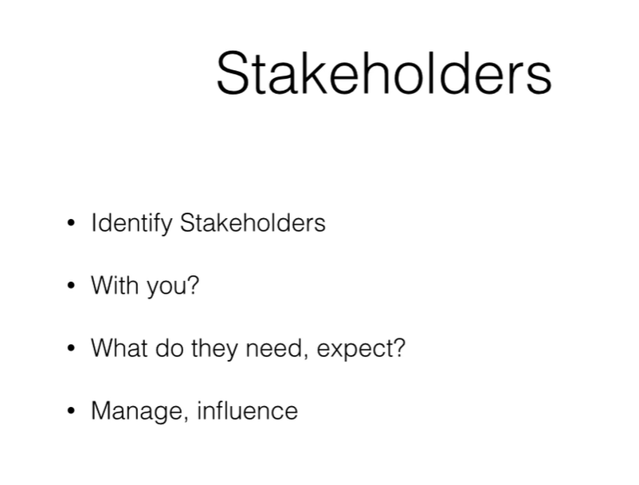
Notes:
Screenshot 2026-10-28 155830.png

Slide 26

Notes:
Screenshot 2026-10-28 155854.png

Slide 27
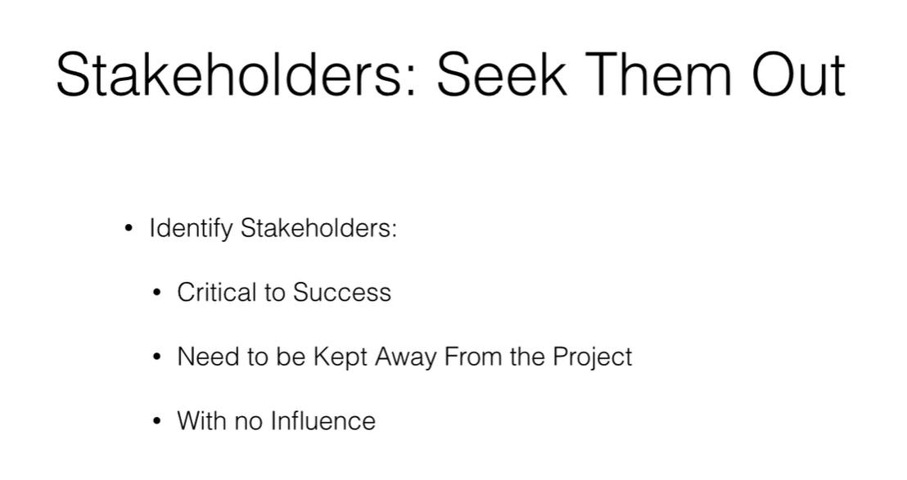
Notes:
Screenshot 2026-10-28 155952.png

Slide 28
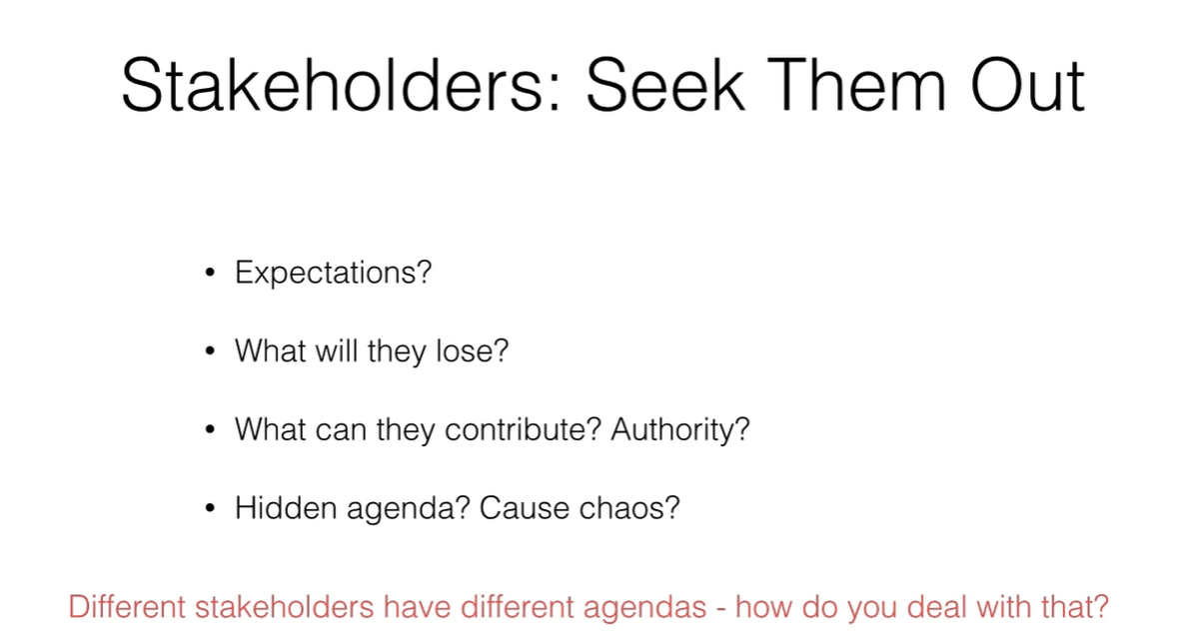
Notes:
Screenshot 2026-10-28 160005.png

Slide 29
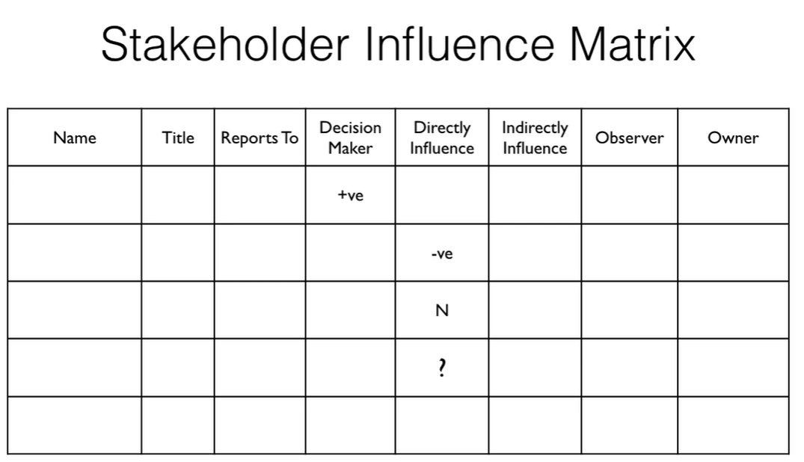
Notes:
Screenshot 2026-10-28 160044.png

Slide 30
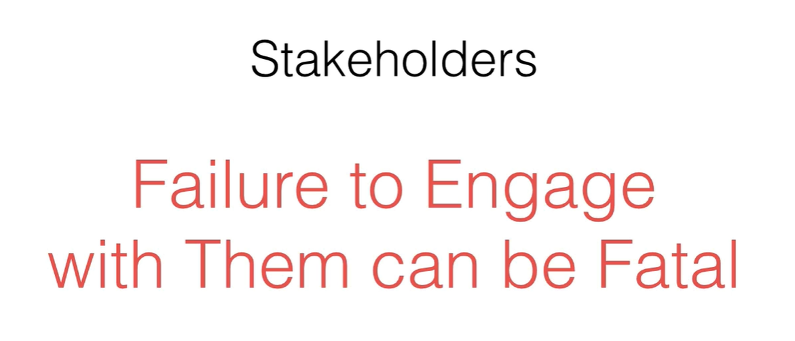
Notes:
Screenshot 2026-10-28 160058.png

Slide 31
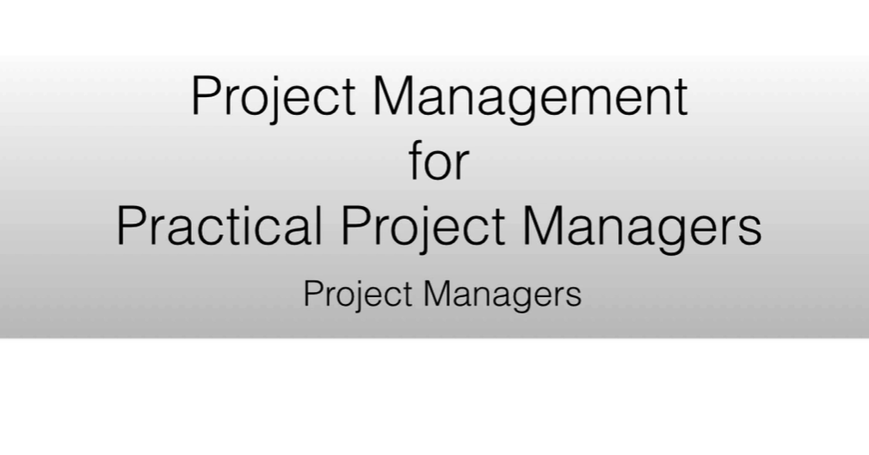
Notes:
Screenshot 2026-10-28 160136.png

Slide 32
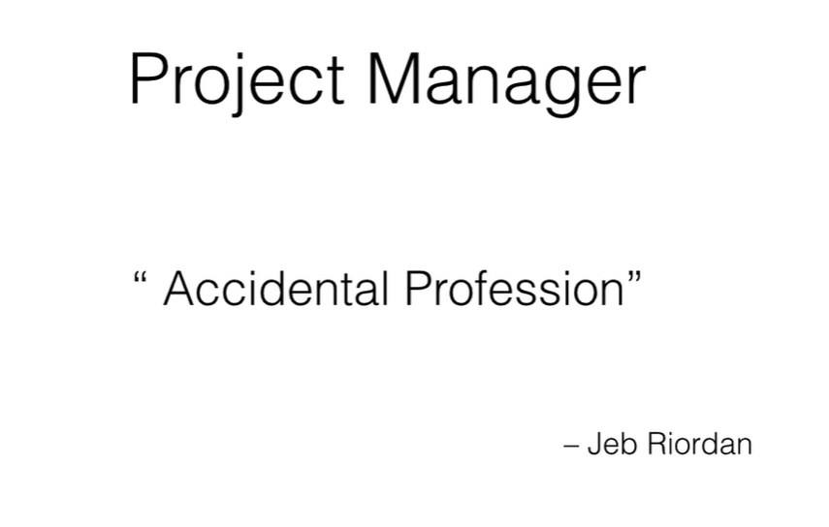
Notes:
Screenshot 2026-10-28 160210.png

Slide 33

Notes:
Screenshot 2026-10-28 160259.png

Slide 34
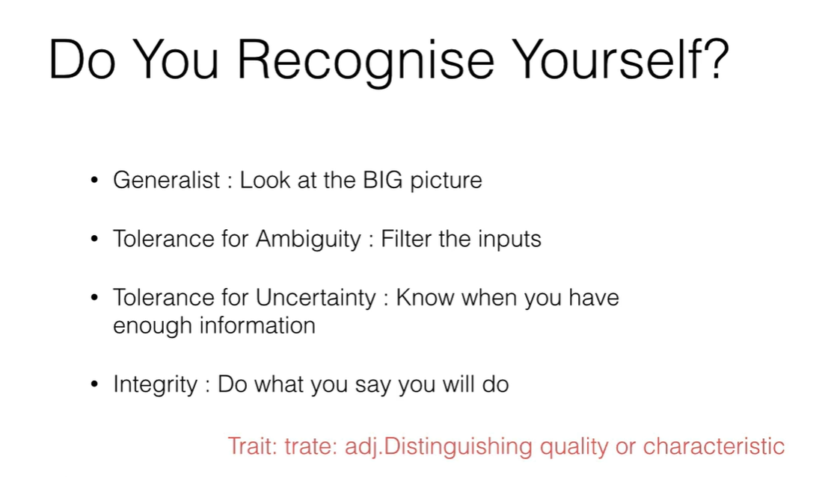
Notes:
Screenshot 2026-10-28 160518.png

Slide 35
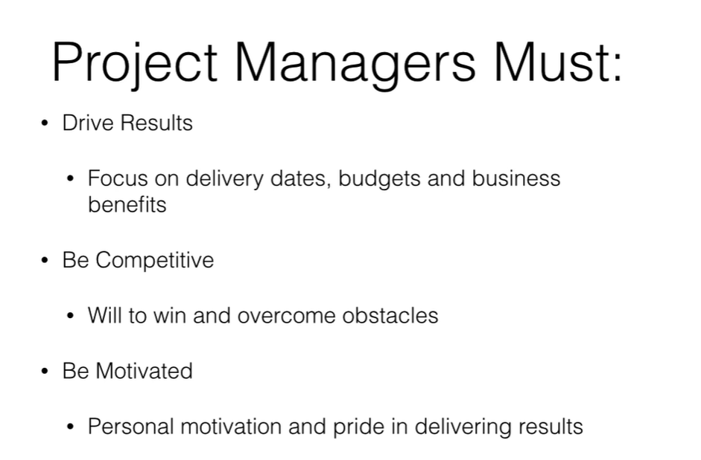
Notes:
Screenshot 2026-10-28 160615.png

Slide 36

Notes:
Screenshot 2026-10-28 160649.png

Slide 37
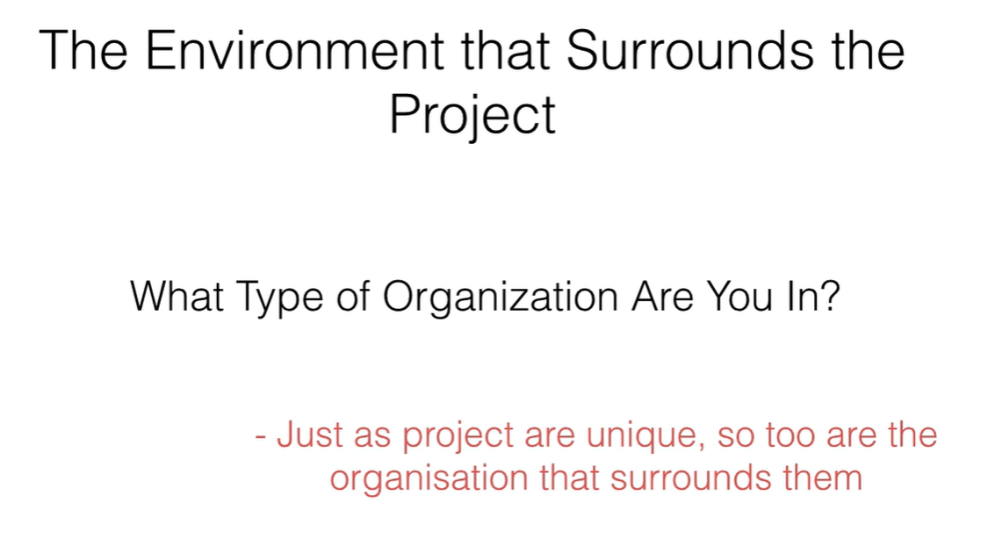
Notes:
Screenshot 2026-10-28 160740.png

Slide 38
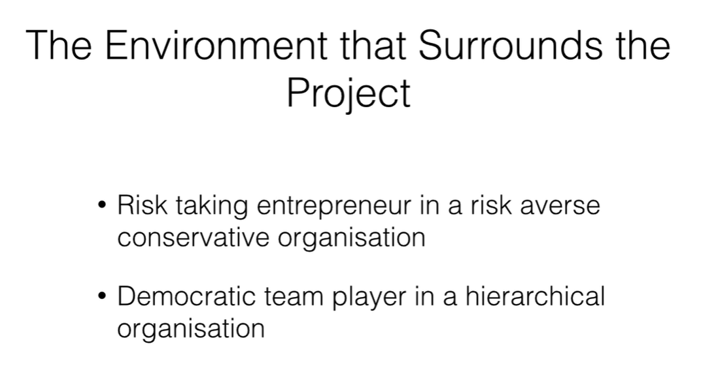
Notes:
Screenshot 2026-10-28 160831.png

Slide 39
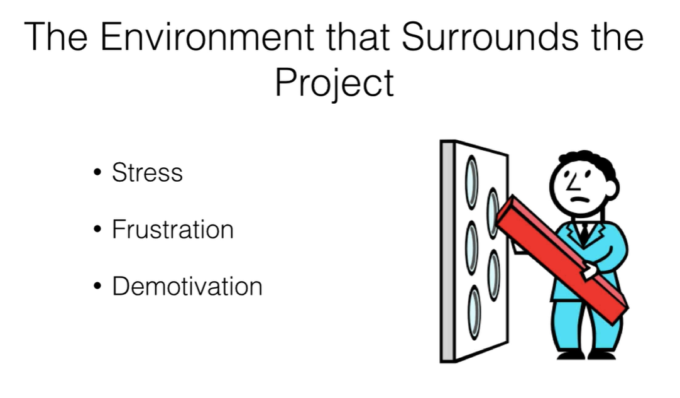
Notes:
Screenshot 2026-10-28 160904.png

Slide 40
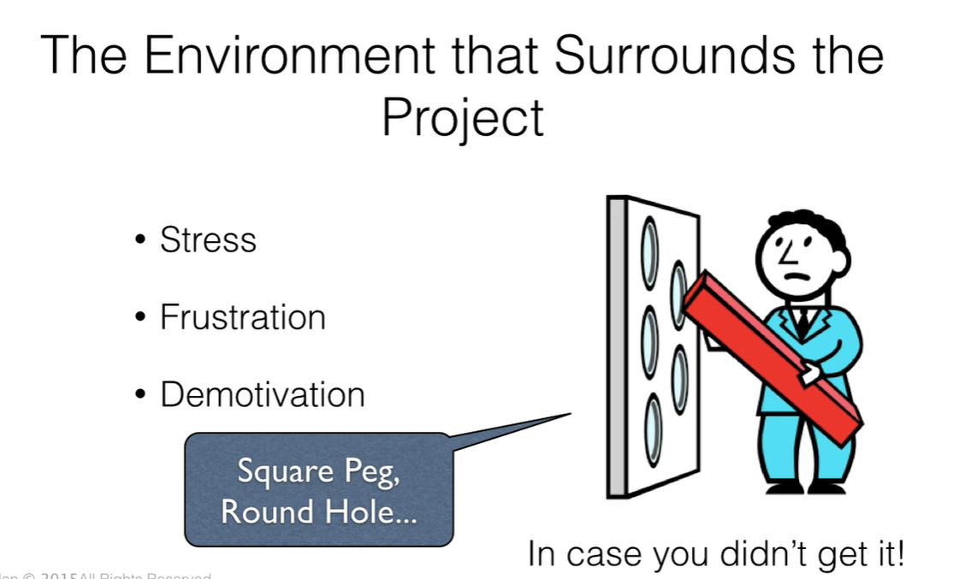
Notes:
Screenshot 2026-10-28 161041.png

Slide 41

Notes:
Screenshot 2026-10-28 175854.png

Slide 42
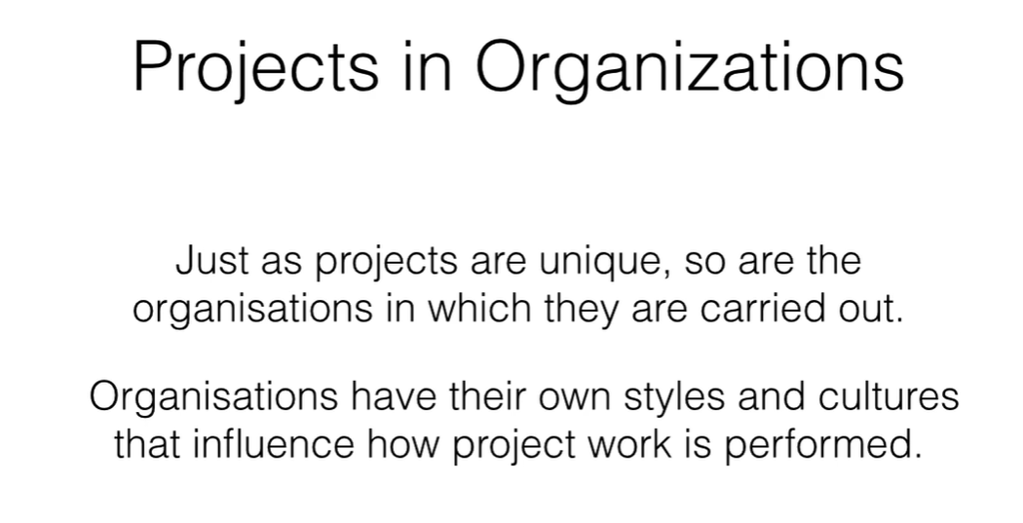
Notes:
Screenshot 2026-10-28 175911.png

Slide 43
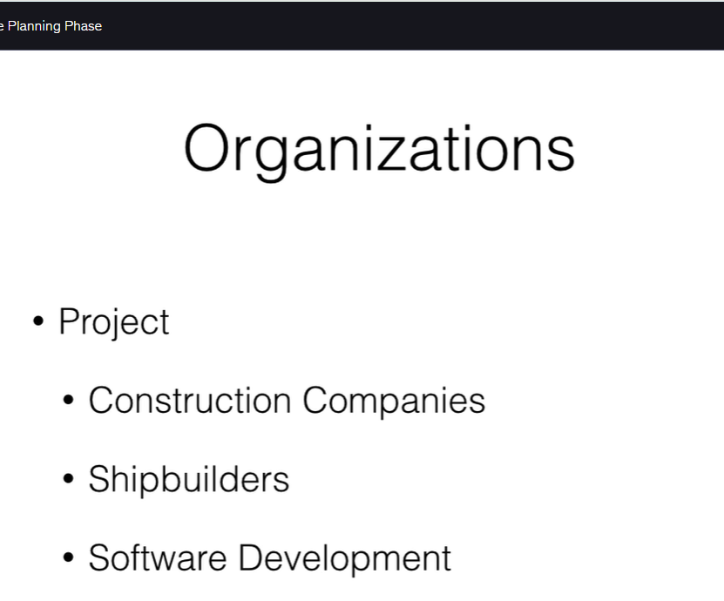
Notes:
Screenshot 2026-10-28 175927.png

Slide 44
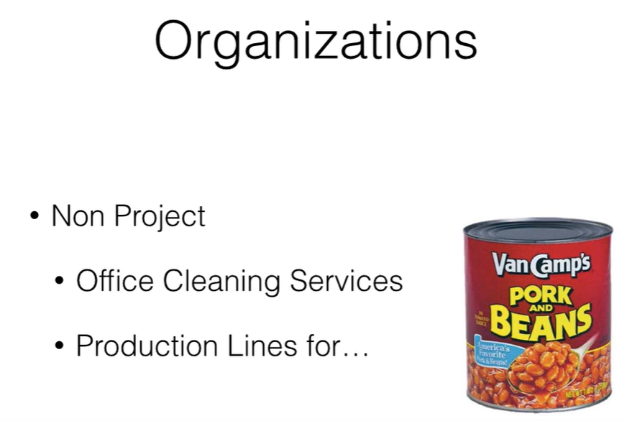
Notes:
Screenshot 2026-10-28 180002.png

Slide 45
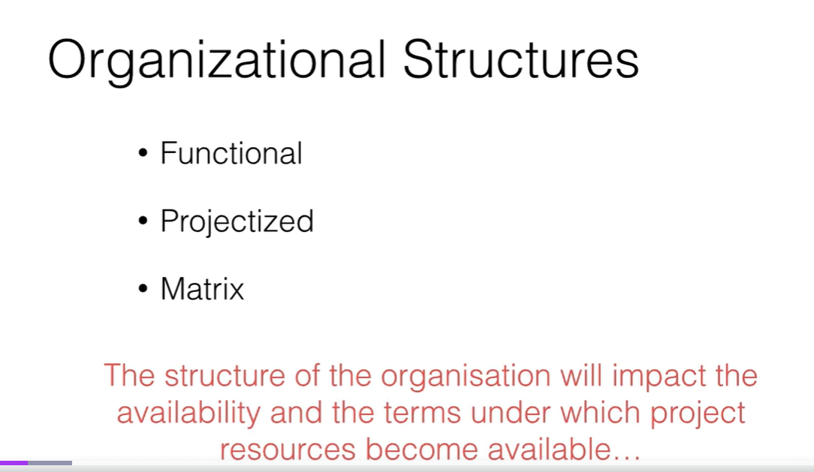
Notes:
Screenshot 2026-10-28 180042.png

Slide 46
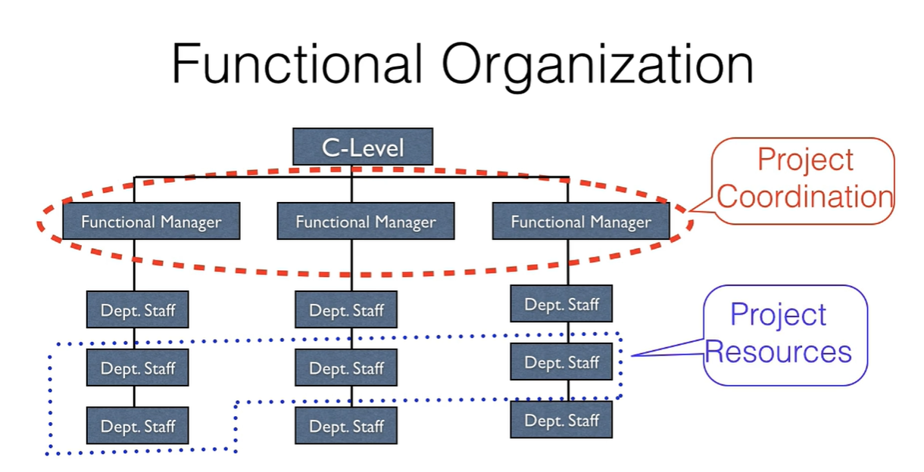
Notes:
Screenshot 2026-10-28 180109.png

Slide 47
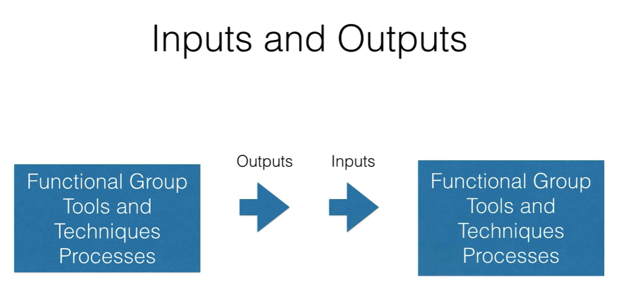
Notes:
Screenshot 2026-10-28 180257.png

Slide 48
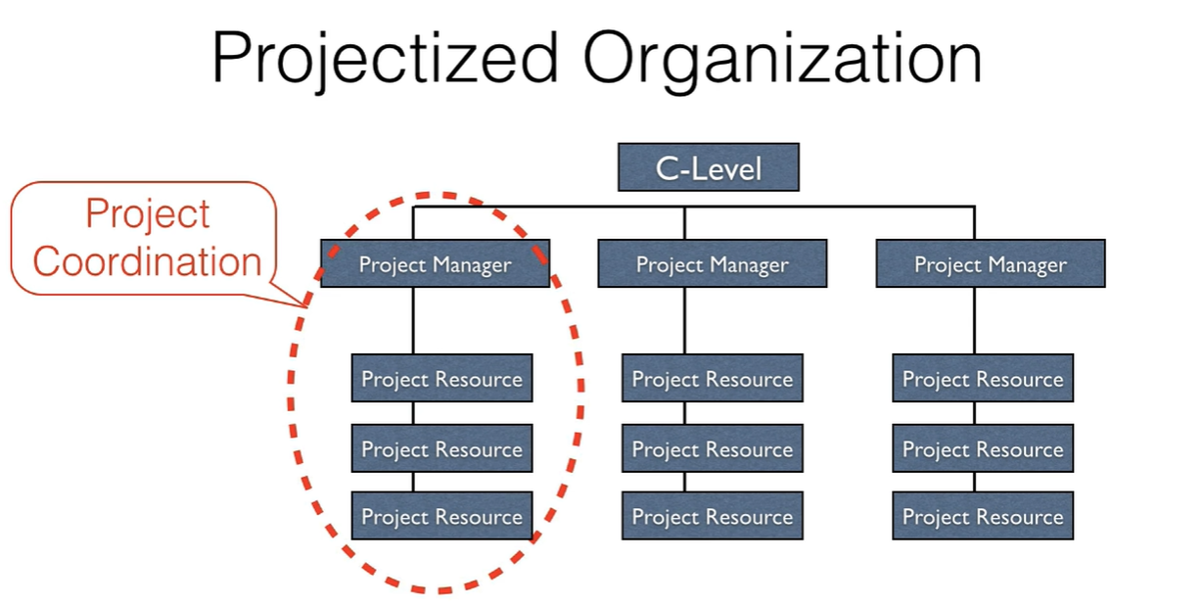
Notes:
Screenshot 2026-10-28 180336.png

Slide 49
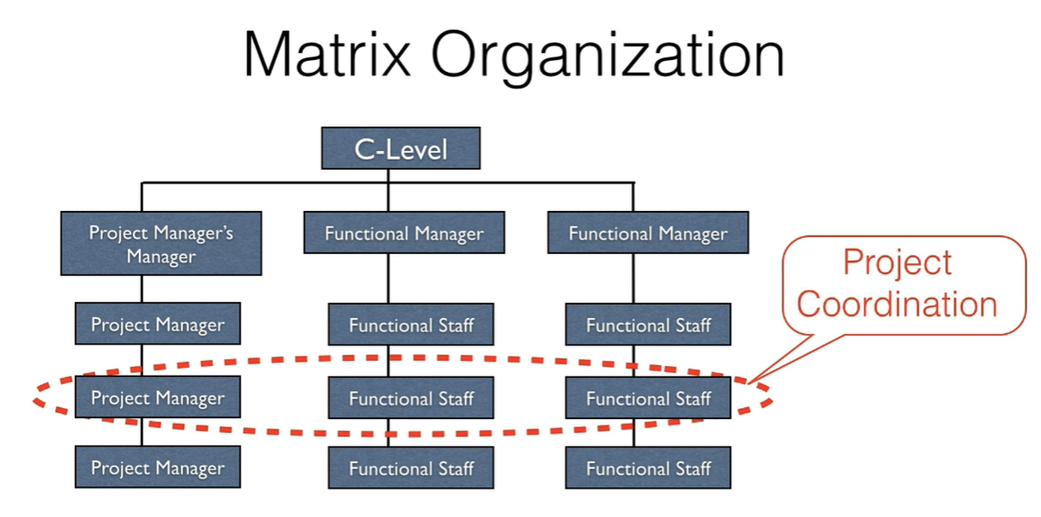
Notes:
Screenshot 2026-10-28 180522.png

Slide 50

Notes:
Screenshot 2026-10-28 180727.png

Slide 51
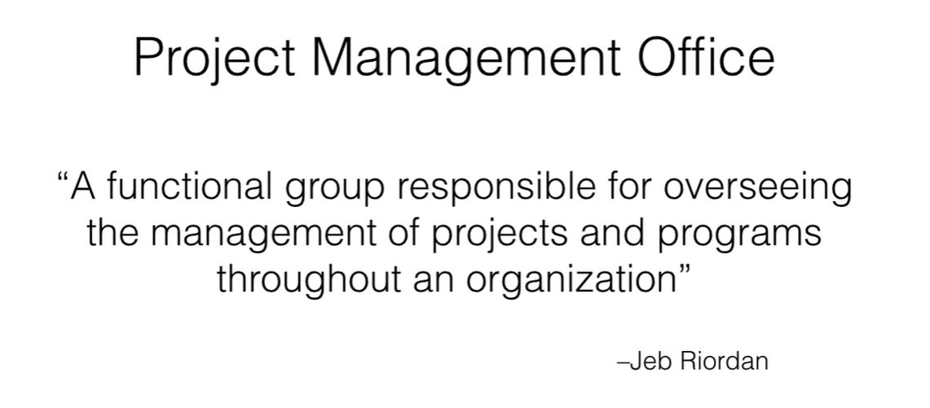
Notes:
Screenshot 2026-10-28 180804.png

Slide 52
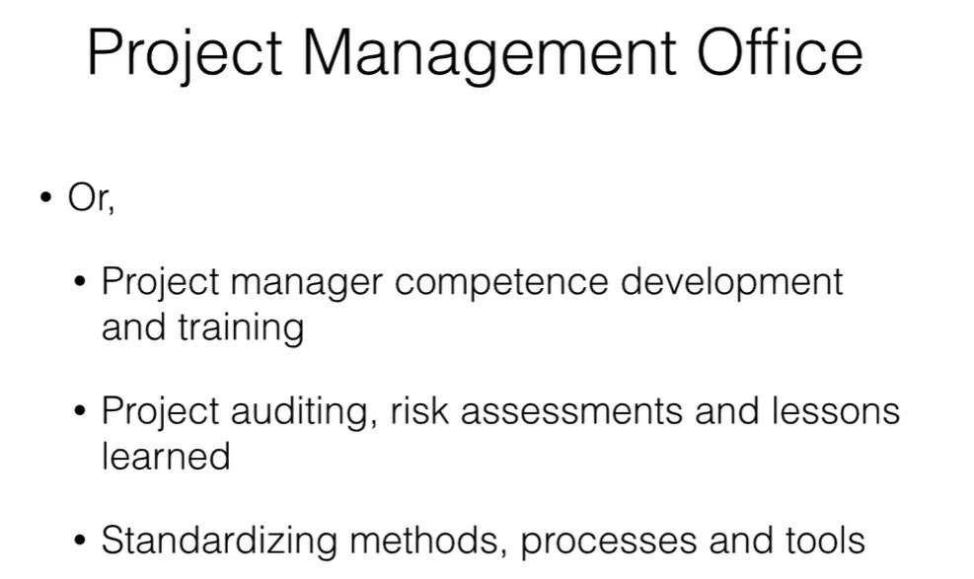
Notes:
Screenshot 2026-10-28 180854.png

Slide 53
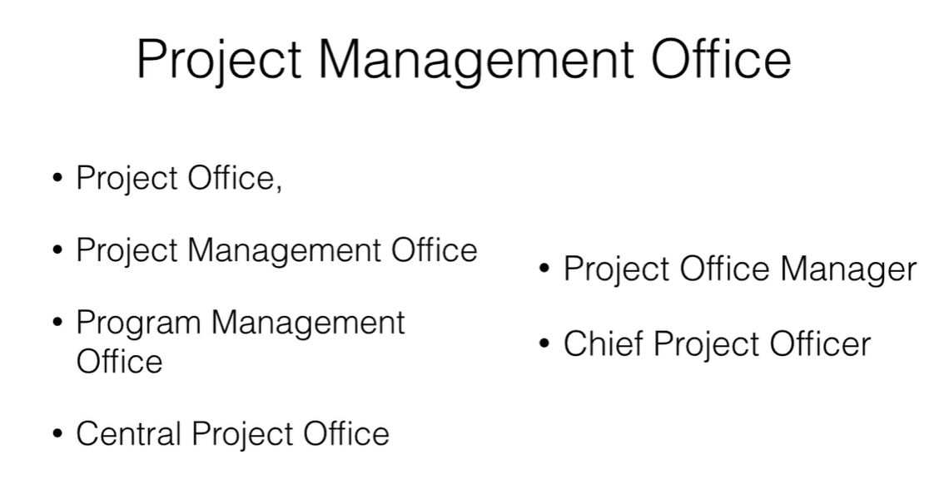
Notes:
Screenshot 2026-10-28 180916.png

Slide 54
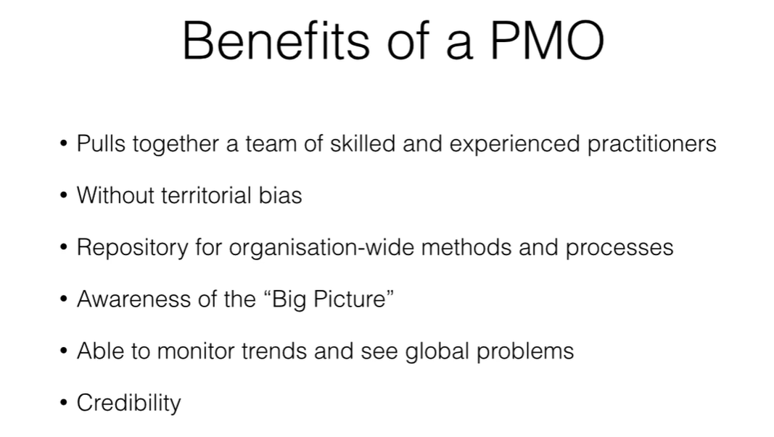
Notes:
Screenshot 2026-10-28 181022.png

Slide 55
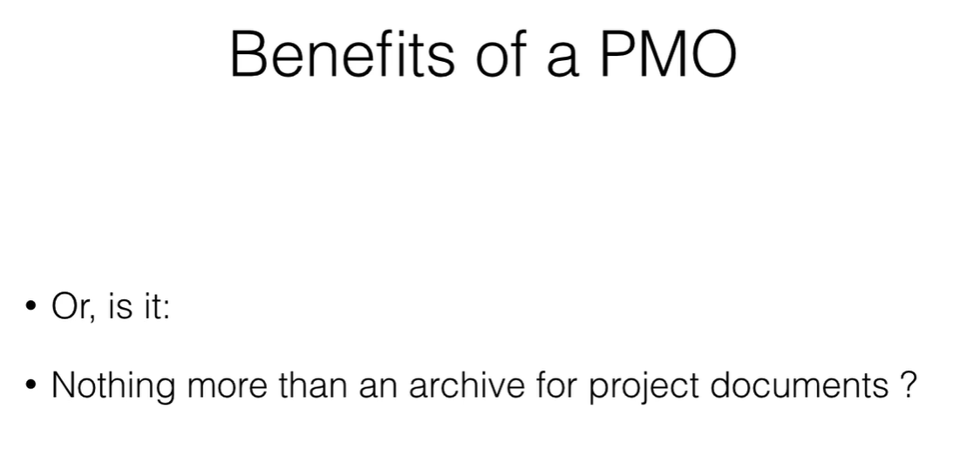
Notes:
Screenshot 2026-10-28 181129.png

Slide 56
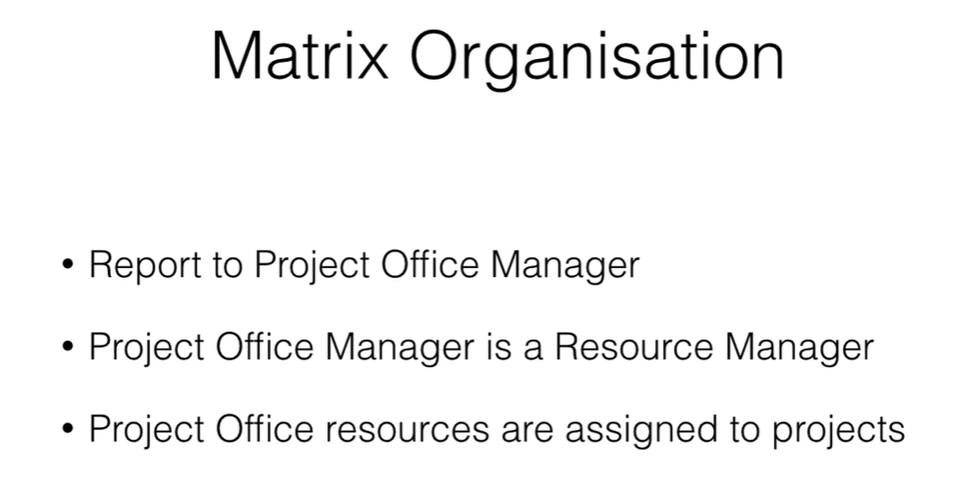
Notes:
Screenshot 2026-10-28 181146.png

Slide 57
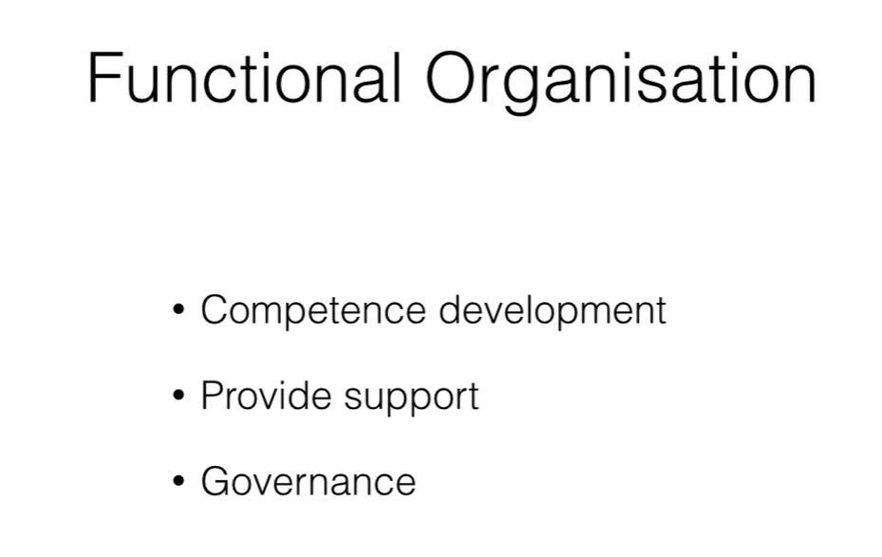
Notes:
Screenshot 2026-10-28 181151.png

Slide 58
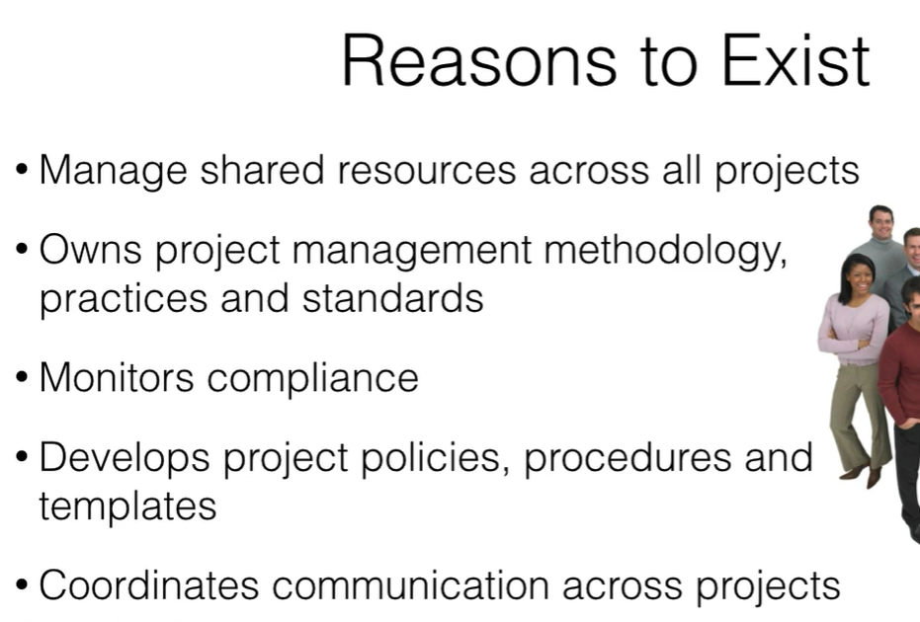
Notes:
Screenshot 2026-10-28 181224.png

Slide 59

Notes:
Screenshot 2026-10-28 181244.png

Slide 60

Notes:
Screenshot 2026-10-28 181334.png

Slide 61

Notes:
Screenshot 2026-10-28 181349.png

Slide 62

Notes:
Screenshot 2026-10-28 181520.png

Slide 63

Notes:
Screenshot 2026-10-28 181539.png

Slide 64

Notes:
Screenshot 2026-10-28 181558.png

Slide 65

Notes:
Screenshot 2026-10-28 181624.png

Slide 66

Notes:
Screenshot 2026-10-28 181642.png

Slide 67

Notes:
Screenshot 2026-10-28 181727.png

Slide 68

Notes:
Screenshot 2026-10-28 181742.png

Slide 69

Notes:
Screenshot 2026-10-28 181750.png

Slide 70

Notes:
Screenshot 2026-10-28 181834.png

Slide 71
Notes:
Screenshot 2026-10-28 181851.png

Slide 72

Notes:
Screenshot 2026-10-28 181859.png

Slide 73

Notes:
Screenshot 2026-10-28 182444.png

Slide 74

Notes:
Screenshot 2026-10-28 182455.png

Slide 75

Notes:
Screenshot 2026-10-28 182534.png

Slide 76

Notes:
Screenshot 2026-10-28 182645.png

Slide 77

Notes:
Screenshot 2026-10-28 182713.png

Slide 78

Notes:
Screenshot 2026-10-28 182819.png

Slide 79

Notes:
Screenshot 2026-10-28 182836.png

Slide 80

Notes:
Screenshot 2026-10-28 182852.png

Slide 81

Notes:
Screenshot 2026-10-28 182928.png

Slide 82

Notes:
Screenshot 2026-10-28 182948.png

Slide 83

Notes:
Screenshot 2026-10-28 183011.png

Slide 84

Notes:
Screenshot 2026-10-28 183032.png

Slide 85

Notes:
Screenshot 2026-10-28 183122.png

Slide 86

Notes:
Screenshot 2026-10-28 183208.png

Slide 87

Notes:
Screenshot 2026-10-28 183230.png

Slide 88

Notes:
Screenshot 2026-10-28 183257.png

Slide 89

Notes:
Screenshot 2026-10-28 183317.png

Slide 90

Notes:
Screenshot 2026-10-28 183335.png

Slide 91

Notes:
Screenshot 2026-10-28 183350.png

Slide 92

Notes:
Screenshot 2026-10-28 183408.png

Slide 93

Notes:
Screenshot 2026-10-28 183552.png

Slide 94

Notes:
Screenshot 2026-10-28 183622.png

Slide 95

Notes:
Screenshot 2026-10-28 183638.png

Slide 96

Notes:
Screenshot 2026-10-28 183719.png

Slide 97

Notes:
Screenshot 2026-10-28 183744.png

Slide 98

Notes:
Screenshot 2026-10-28 183817.png

Slide 99

Notes:
Screenshot 2026-10-28 183906.png

Slide 100

Notes:
Screenshot 2026-10-28 183943.png

Slide 101

Notes:
Screenshot 2026-10-28 184037.png

Slide 102

Notes:
Screenshot 2026-10-28 184056.png

Slide 103

Notes:
Screenshot 2026-10-28 184111.png

Slide 104

Notes:
Screenshot 2026-10-28 184200.png

Slide 105

Notes:
Screenshot 2026-10-28 184214.png

Slide 106

Notes:
Screenshot 2026-10-28 184336.png

Slide 107

Notes:
Screenshot 2026-10-28 184403.png

Slide 108

Notes:
Screenshot 2026-10-28 184427.png

Slide 109

Notes:
Screenshot 2026-10-28 184443.png

Slide 110

Notes:
Screenshot 2026-10-28 184509.png

Slide 111

Notes:
Screenshot 2026-10-28 184617.png

Slide 112

Notes:
Screenshot 2026-10-28 184716.png

Slide 113

Notes:
Screenshot 2026-10-28 184727.png

Slide 114

Notes:
Screenshot 2026-10-28 184806.png

Slide 115

Notes:
Screenshot 2026-10-28 184911.png

Slide 116

Notes:
Screenshot 2026-10-28 184930.png

Slide 117

Notes:
Screenshot 2026-10-28 185012.png

Slide 118

Notes:
Screenshot 2026-10-28 185027.png

Slide 119

Notes:
Screenshot 2026-10-28 185045.png

Slide 120

Notes:
Screenshot 2026-10-28 185112.png

Slide 121

Notes:
Screenshot 2026-10-28 185137.png

Slide 122

Notes:
Screenshot 2026-10-28 185159.png

Slide 123

Notes:
Screenshot 2026-10-28 185216.png

Slide 124

Notes:
Screenshot 2026-10-28 185223.png

Slide 125

Notes:
Screenshot 2026-10-28 185253.png

Slide 126

Notes:
Screenshot 2026-10-28 185259.png

Slide 127

Notes:
Screenshot 2026-10-28 185316.png

Slide 128

Notes:
Screenshot 2026-10-28 185336.png

Slide 129

Notes:
Screenshot 2026-10-28 185354.png

Slide 130

Notes:
Screenshot 2026-10-28 185433.png

Slide 131

Notes:
Screenshot 2026-10-28 185446.png

Slide 132

Notes:
Screenshot 2026-10-28 185526.png

Slide 133

Notes:
Screenshot 2026-10-28 185549.png

Slide 134

Notes:
Screenshot 2026-10-28 185629.png

Slide 135

Notes:
Screenshot 2026-10-28 185651.png

Slide 136

Notes:
Screenshot 2026-10-28 185713.png

Slide 137

Notes:
Screenshot 2026-10-28 185740.png

Slide 138

Notes:
Screenshot 2026-10-28 185755.png

Slide 139

Notes:
Screenshot 2026-10-28 185824.png

Slide 140

Notes:
Screenshot 2026-10-28 185909.png

Slide 141

Notes:
Screenshot 2026-10-28 185924.png

Slide 142

Notes:
Screenshot 2026-10-28 190018.png

Slide 143

Notes:
Screenshot 2026-10-28 190028.png

Slide 144

Notes:
Screenshot 2026-10-28 190059.png

Slide 145

Notes:
Screenshot 2026-10-28 190202.png

Slide 146

Notes:
Screenshot 2026-10-28 190227.png

Slide 147

Notes:
Screenshot 2026-10-28 190247.png

Slide 148

Notes:
Screenshot 2026-10-28 190254.png

Slide 149

Notes:
Screenshot 2026-10-28 190320.png

Slide 150

Notes:
Screenshot 2026-10-28 190331.png

Slide 151

Notes:
Screenshot 2026-10-28 190339.png

Slide 152

Notes:
Screenshot 2026-10-28 190411.png

Slide 153

Notes:
Screenshot 2026-10-28 190424.png

Slide 154

Notes:
Screenshot 2026-10-28 190442.png

Slide 155

Notes:
Screenshot 2026-10-28 190503.png

Slide 156

Notes:
Screenshot 2026-10-28 190534.png

Slide 157

Notes:
Screenshot 2026-10-28 190559.png

Slide 158

Notes:
Screenshot 2026-10-28 191141.png

Slide 159

Notes:
Screenshot 2026-10-28 191153.png

Slide 160

Notes:
Screenshot 2026-10-28 191206.png

Slide 161

Notes:
Screenshot 2026-10-28 191226.png

Slide 162

Notes:
Screenshot 2026-10-28 191250.png

Slide 163

Notes:
Screenshot 2026-10-28 191344.png

Slide 164

Notes:
Screenshot 2026-10-28 191401.png

Slide 165

Notes:
Screenshot 2026-10-28 191412.png

Slide 166

Notes:
Screenshot 2026-10-28 191445.png

Slide 167

Notes:
Screenshot 2026-10-28 191509.png

Slide 168

Notes:
Screenshot 2026-10-28 191549.png

Slide 169

Notes:
Screenshot 2026-10-28 191613.png

Slide 170

Notes:
Screenshot 2026-10-28 191719.png

Slide 171

Notes:
Screenshot 2026-10-28 191759.png

Slide 172

Notes:
Screenshot 2026-10-28 191816.png

Slide 173

Notes:
Screenshot 2026-10-28 191825.png

Slide 174

Notes:
Screenshot 2026-10-28 191840.png

Slide 175

Notes:
Screenshot 2026-10-28 192018.png

Slide 176

Notes:
Screenshot 2026-10-28 192046.png

Slide 177

Notes:
Screenshot 2026-10-28 192053.png

Slide 178

Notes:
Screenshot 2026-10-28 192102.png

Slide 179

Notes:
Screenshot 2026-10-28 192112.png

Slide 180

Notes:
Screenshot 2026-10-28 192148.png

Slide 181

Notes:
Screenshot 2026-10-28 192217.png

Slide 182

Notes:
Screenshot 2026-10-28 192231.png

Slide 183

Notes:
Screenshot 2026-10-28 192248.png

Slide 184

Notes:
Screenshot 2026-10-28 192310.png

Slide 185

Notes:
Screenshot 2026-10-28 192316.png

Slide 186

Notes:
Screenshot 2026-10-28 192330.png

Slide 187

Notes:
Screenshot 2026-10-28 192348.png

Slide 188

Notes:
Screenshot 2026-10-28 192501.png

Slide 189

Notes:
Screenshot 2026-10-28 194547.png

Slide 190

Notes:
Screenshot 2026-10-28 195126.png

Slide 191

Notes:
Screenshot 2026-10-28 195132.png

Slide 192

Notes:
Screenshot 2026-10-28 195203.png

Slide 193

Notes:
Screenshot 2026-10-28 195410.png

Slide 194

Notes:
Screenshot 2026-10-28 195417.png

Slide 195

Notes:
Screenshot 2026-10-28 195456.png

Slide 196

Notes:
Screenshot 2026-10-28 195519.png

Slide 197

Notes:
Screenshot 2026-10-28 195553.png

Slide 198

Notes:
Screenshot 2026-10-28 195608.png

Slide 199

Notes:
Screenshot 2026-10-28 195645.png

Slide 200

Notes:
Screenshot 2026-10-28 195715.png

Slide 201

Notes:
Screenshot 2026-10-28 195727.png

Slide 202

Notes:
Screenshot 2026-10-28 195748.png

Slide 203

Notes:
Screenshot 2026-10-28 195904.png

Slide 204

Notes:
Screenshot 2026-10-28 200006.png

Slide 205

Notes:
Screenshot 2026-10-28 200028.png

Slide 206

Notes:
Screenshot 2026-10-28 200052.png

Slide 207

Notes:
Screenshot 2026-10-28 200105.png

Slide 208

Notes:
Screenshot 2026-10-28 200255.png

Slide 209

Notes:
Screenshot 2026-10-28 200414.png

Slide 210

Notes:
Screenshot 2026-10-28 200427.png

Slide 211

Notes:
Screenshot 2026-10-29 054743.png

Slide 212

Notes:
Screenshot 2026-10-29 054904.png

Slide 213

Notes:
Screenshot 2026-10-29 054958.png

Slide 214

Notes:
Screenshot 2026-10-29 055029.png

Slide 215

Notes:
Screenshot 2026-10-29 055055.png

Slide 216

Notes:
Screenshot 2026-10-29 055131.png

Slide 217

Notes:
Screenshot 2026-10-29 055152.png

Slide 218

Notes:
Screenshot 2026-10-29 055303.png

Slide 219

Notes:
Screenshot 2026-10-29 055338.png

Slide 220

Notes:
Screenshot 2026-10-29 055400.png

Slide 221

Notes:
Screenshot 2026-10-29 055440.png

Slide 222

Notes:
Screenshot 2026-10-29 055516.png

Slide 223

Notes:
Screenshot 2026-10-29 055537.png

Slide 224

Notes:
Screenshot 2026-10-29 055613.png

Slide 225

Notes:
Screenshot 2026-10-29 055632.png

Slide 226

Notes:
Screenshot 2026-10-29 055803.png

Slide 227

Notes:
Screenshot 2026-10-29 055905.png

Slide 228

Notes:
Screenshot 2026-10-29 060001.png

Slide 229

Notes:
Screenshot 2026-10-29 060057.png

Slide 230

Notes:
Screenshot 2026-10-29 060150.png

Slide 231

Notes:
Screenshot 2026-10-29 060226.png

Slide 232

Notes:
Screenshot 2026-10-29 060252.png

Slide 233

Notes:
Screenshot 2026-10-29 060312.png

Slide 234

Notes:
Screenshot 2026-10-29 060351.png

Slide 235

Notes:
Screenshot 2026-10-29 060419.png

Slide 236

Notes:
Screenshot 2026-10-29 060430.png

Slide 237

Notes:
Screenshot 2026-10-29 060512.png

Slide 238

Notes:
Screenshot 2026-10-29 060601.png

Slide 239

Notes:
Screenshot 2026-10-29 060623.png

Slide 240

Notes:
Screenshot 2026-10-29 060639.png

Slide 241

Notes:
Screenshot 2026-10-29 060652.png

Slide 242

Notes:
Screenshot 2026-10-29 060736.png

Slide 243

Notes:
Screenshot 2026-10-29 060743.png

Slide 244

Notes:
Screenshot 2026-10-29 060802.png

Slide 245

Notes:
Screenshot 2026-10-29 061057.png

Slide 246

Notes:
Screenshot 2026-10-29 061117.png

Slide 247

Notes:
Screenshot 2026-10-29 061229.png

Slide 248

Notes:
Screenshot 2026-11-01 073417.png

Slide 249

Notes:
Screenshot 2026-11-03 162856.png

Slide 250

Notes:
Screenshot 2026-11-03 163110.png

Slide 251

Notes:
Screenshot 2026-11-03 163141.png

Slide 252

Notes:
Screenshot 2026-11-03 163230.png

Slide 253

Notes:
Screenshot 2026-11-03 221000.png

Slide 254

Notes:
Screenshot 2026-11-03 221011.png

Slide 255

Notes:
Screenshot 2026-11-03 221047.png

Slide 256

Notes:
Screenshot 2026-11-03 221144.png

Slide 257

Notes:
Screenshot 2026-11-03 221217.png

Slide 258

Notes:
Screenshot 2026-11-03 221253.png

Slide 259

Notes:
Screenshot 2026-11-03 221326.png

Slide 260

Notes:
Screenshot 2026-11-03 221806.png

Slide 261

Notes:
Screenshot 2026-11-03 221830.png

Slide 262

Notes:
Screenshot 2026-11-03 221854.png

Slide 263

Notes:
Screenshot 2026-11-03 221916.png

Slide 264

Notes:
Screenshot 2026-11-03 221938.png

Slide 265

Notes:
Screenshot 2026-11-03 221951.png

